Slide 1
Operating Systems and Virtualization

Slide 2
Operating System (OS)
An Operating System (OS) is an interface (pathway) between a computer user and computer hardware. An operating system is a software which performs all the basic tasks like file management, memory management, error handling, process management, handling input and output, and controlling peripheral devices such as disk drives and printers.
An operating system is a program that acts as an interface between the user and the computer hardware and controls the execution of all kinds of programs.

Slide 3
Operating System (OS)
OS is a resource allocator
Manages all resources
Decides between conflicting requests for efficient and fair resource use so memory doesn’t exhausts out.
OS is a control program
Controls execution of programs to prevent errors and improper use of the computer

Slide 4
Different Types of OS
There are different types of operating systems such as:
Windows
MacOS
ChromeOS
Linux
DOS
iOS
Android etc.

Slide 5
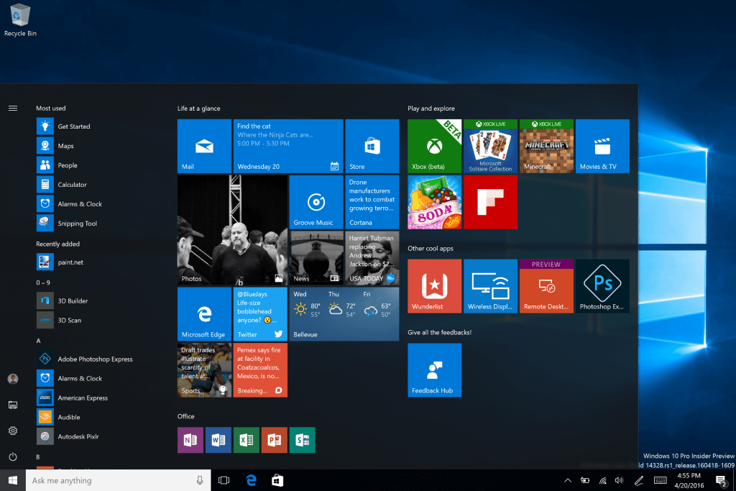
Windows

Slide 6
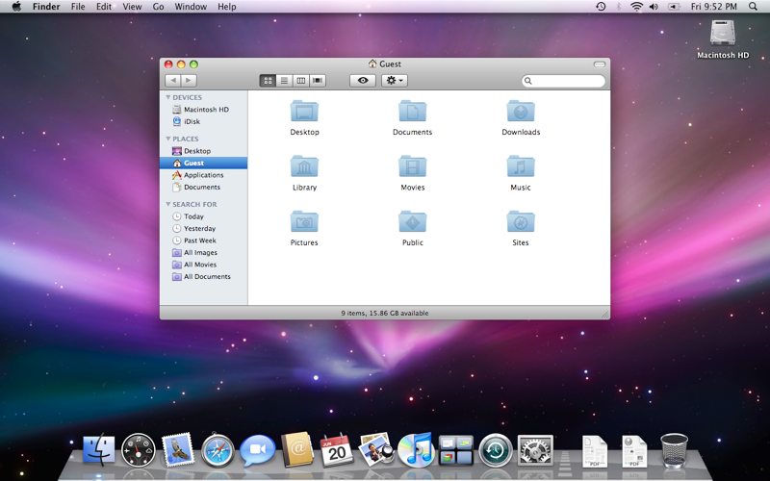
MacOS

Slide 7
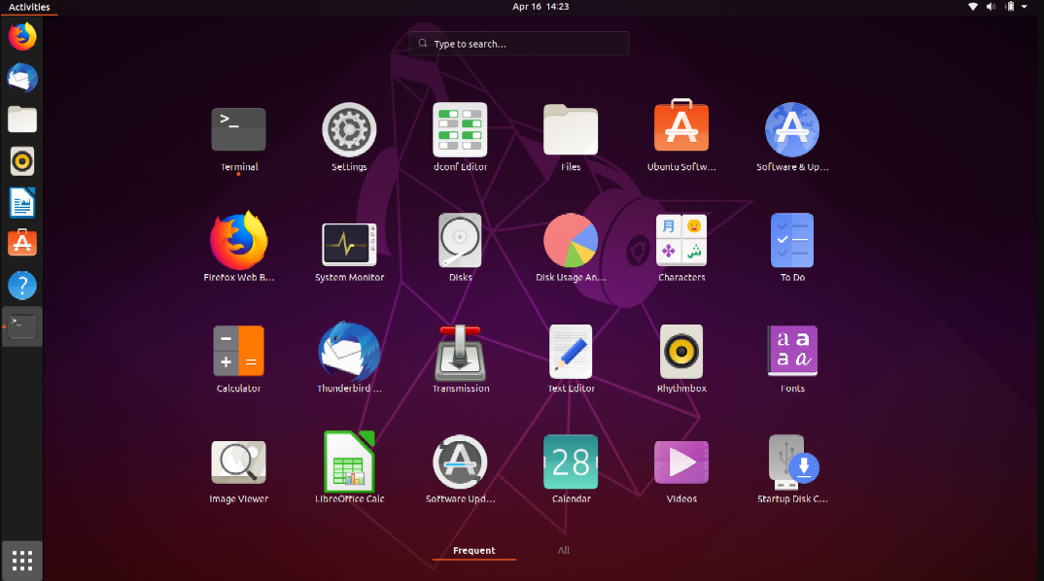
Linux

Slide 8
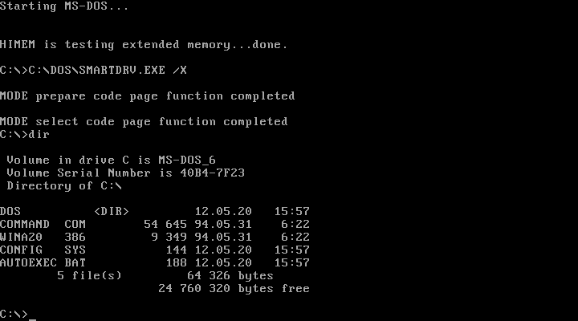
DOS

Slide 9
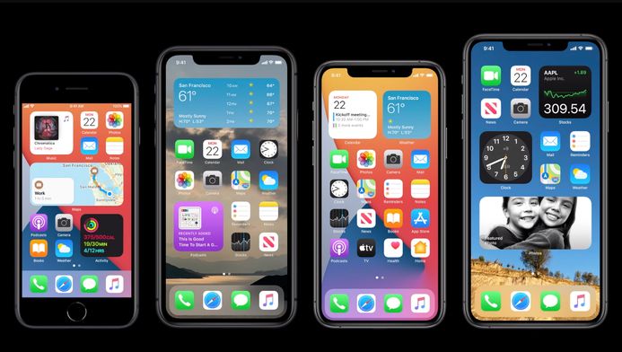
iOS

Slide 10
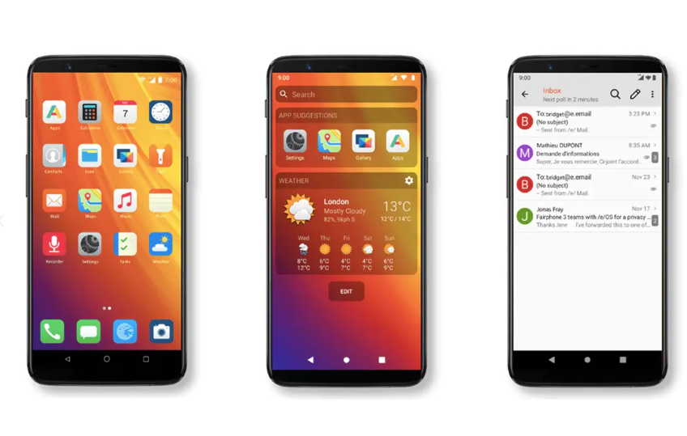
Android

Slide 11
Following are some of important functions of an operating System:
Memory Management
Processor Management
Device Management
File Management
Security
Control over system performance
Job accounting
Error detecting aids
Coordination between other software and users

Slide 12
Memory Management
Memory management refers to management of Primary Memory or Main Memory. Main memory is a large array of words or bytes where each word or byte has its own address.
An Operating System does the following activities for memory management −
Keeps tracks of primary memory, i.e., what part of it are in use by whom, what part are not in use.
In multiprogramming, the OS decides which process will get memory when and how much.
Allocates the memory when a process requests it to do so.
De-allocates the memory when a process no longer needs it or has been terminated

Slide 13
Processor Management
In multiprogramming environment, the OS decides which process gets the processor when and for how much time. This function is called process scheduling. An Operating System does the following activities for processor management −
Keeps tracks of processor and status of process. The program responsible for this task is known as traffic controller.
Allocates the processor (CPU) to a process.
De-allocates processor when a process is no longer required.

Slide 14
Device Management
An Operating System manages device communication via their respective drivers. It does the following activities for device management −
Keeps tracks of all devices. Program responsible for this task is known as the I/O controller.
Decides which process gets the device when and for how much time.
Allocates and de-allocates the devices in the efficient way.

Slide 15
File Management
A file system is normally organized into directories for easy navigation and usage. These directories may contain files and other sub-directions.
An Operating System does the following activities for file management −
Keeps track of information, location, uses, status etc. The collective facilities are often known as file system.
Decides who gets the resources.
Allocates the resources.
De-allocates the resources.

Slide 16
Security − By means of password and similar other techniques, it prevents unauthorized access to programs and data.
Control over system performance − Recording delays between request for a service and response from the system.
Job accounting − Keeping track of time and resources used by various jobs and users.
Error detecting aids − Production of dumps, traces, error messages, and other debugging and error detecting aids.
Coordination between other software's and users − Coordination and assignment of compilers, interpreters, assemblers and other software to the various users of the computer systems.

Slide 17
Tasks of the Operating System:
Accepts inputs from the mouse or keyboard.
Sends outputs to the monitor or printer.
Recognizes peripheral devices such as external hard disks, pen drive, web cam etc. and makes sure that software (driver) needed for the hardware to run is installed.
Manages files and folders in the system (Naming, Creating, Moving, Finding and Deleting folders etc.)
Allows applications software (word-processing, spreadsheets etc.) to communicate with the system's hardware.

Slide 18
Tasks of the Operating System:
Shares out system memory efficiently. The operating system will decide how much memory to assign to particular tasks. It also moves data in and out of memory.
Loads and runs software applications.
Manages system security. For example - allows passwords to be added / changed.
Handles system problems and alerts the user. For example if a printer is jammed and cannot printer, the operating system will stop the print job and alert the user with a warning message.
Manages the moving of data to and from a hard disk.

Slide 19
Types of OS Interfaces
The way (medium through which) in which users communicate with the computer is called an 'interface'. The interface is what we use to give the computer commands. There are three types of operating system interfaces:
Command Line Interface (CLI)
Graphical User Interface (GUI)
Touchscreen Interface

Slide 20
Command Line Interface (CLI)
A command line interface is an older style operating system where users type in commands using keyboard.
Command Line Interface's do not make use of images, icons or graphics. All the user is sees is a plain black screen like the one to the right.
Because they use no graphics they require very little computer power.
There are over 270 different commands that can be entered at the command prompt. Commands have to be entered precisely without spelling mistakes or else the operating system will return an error.
Remembering commands and the exact way to enter them can be difficult and so Command Line Interface Operating Systems are considered hard to use.

Slide 21
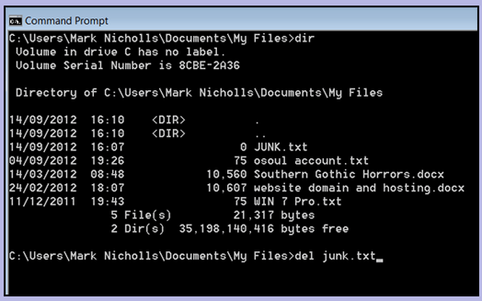
Command Line Interface (CLI)

Slide 22
Graphical User Interface (GUI)
GUI's are visual (graphical) interfaces and they are more popular than CLI's because they are very easy to use. The graphics do need more computer power however.
Instead of typing in commands, the user can use a mouse to point and click objects on the screen. For example: A user can erase a file by right clicking and then selecting delete.
The main features of a GUI are Windows, Icons, Menus and Pointers.

Slide 23
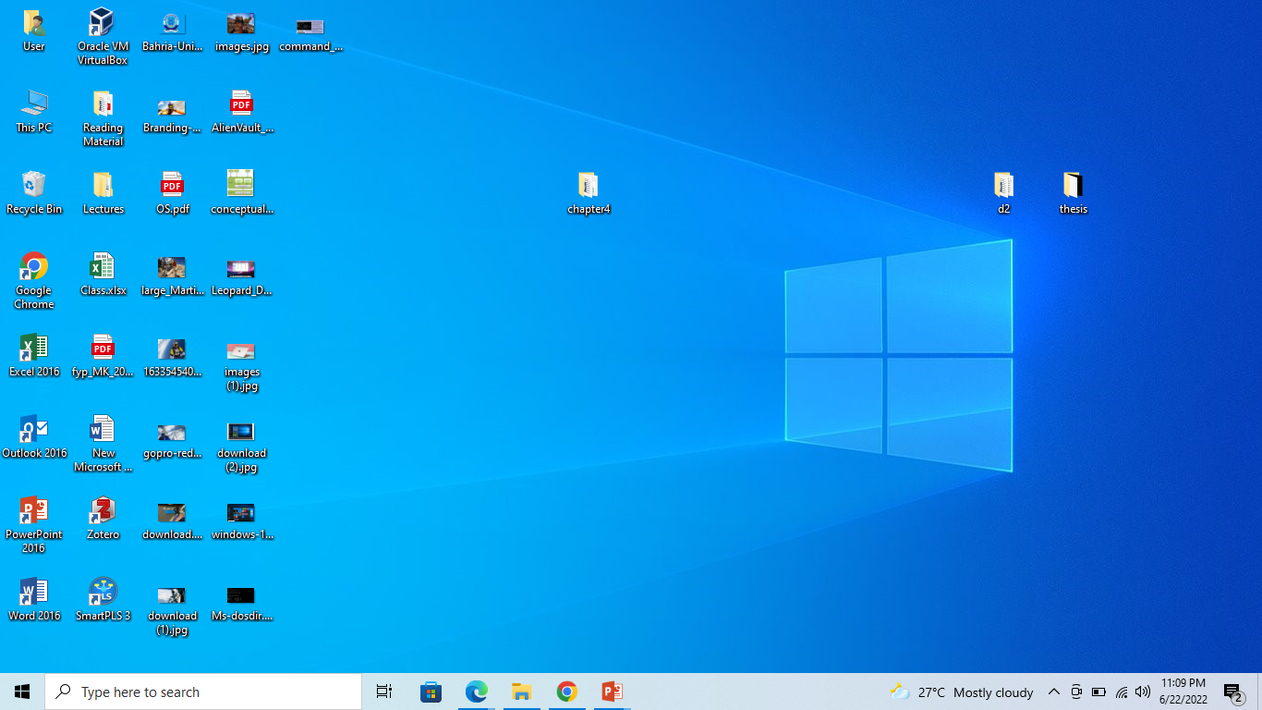
Graphical User Interface (GUI)

Slide 24
Touchscreen Interfaces
Portable devices such as mobile phones, PDA's and tablets (e.g. IPad) use interfaces similar to a GUI where icons and menus are used to input commands.
However, because these devices don't have room for a mouse, the way in which the icons and menus are used is different. (through gestures)
Touchscreen technology allows people to use their fingers to select icons and options straight from the device's screen.

Slide 25
Virtualization
Virtualization creates a simulated, or virtual, computing environment as opposed to a physical environment. Virtualization often includes computer-generated versions of hardware, operating systems, storage devices, and more.
A virtualization software can allow you to create several “virtual computers” (for example 3) within one. Thus, the software will create the “illusion” of generating 3 different computers, each one with its own operating system and its own resources.
Types: full virtualization, para-virtualization, and OS-level virtualization.
Use to test network test servers or beta applications on different OS.

